Slide 1

BUSINESS ADMINISTRATION
SOFTWARE
ALA-TOO INTERNATIONAL UNIVERSITY
Spring Semester 2025-2026

Slide 2
***
Without data,
you’re just another person with an opinion.
— W. Edwards Deming

Slide 3
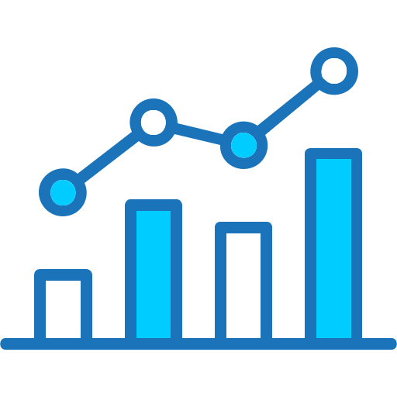
ANALYTICS & DASHBOARDS COURSE PROGRESSION
ERP → CRM → ANALYTICS
ERP records operations CRM records customers
Analytics transforms system data into decision control
This week: control through measurement

Slide 4

THE DATA PROBLEM OVERLOAD AND COMPLEXITY
ERP and CRM systems generate millions of transactions
Managers CANNOT interpret raw operational logs
They need structured signals

Slide 5

WHAT IS ANALYTICS? FORMAL DEFINITION

Slide 6

WHAT IS ANALYTICS? FORMAL DEFINITION
Analytics is the structured transformation of operational data into measurable indicators that reduce uncertainty and support decision-making.

Slide 7
WHAT IS KPI? FORMAL DEFINITION

Slide 8
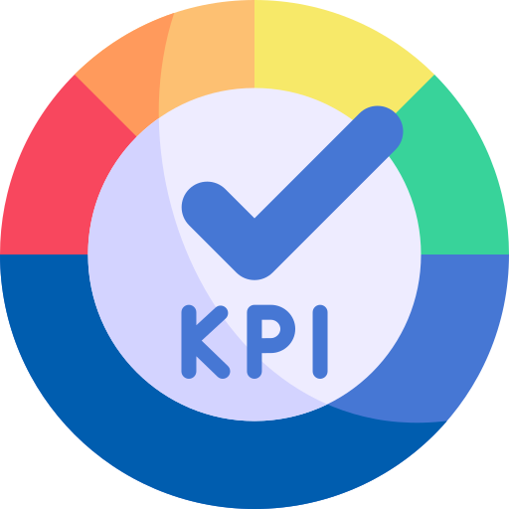
WHAT IS KPI? FORMAL DEFINITION
A Key Performance Indicator (KPI) is a quantifiable metric that reflects how effectively an organization, department, or process is achieving a defined business objective. It is directly linked to strategy, has clearly defined measurement criteria, and includes performance thresholds that trigger evaluation or corrective action.

Slide 9
KPI ANALOGY
When you drive, you do not monitor every engine component. You look at indicators such as speed, fuel level, or engine temperature.
If the temperature rises above a safe limit, you take action.
If fuel is low, you refuel.
Similarly, managers do not monitor every transaction. They monitor KPIs such as revenue, conversion rate, or cost variance. When a KPI crosses a defined threshold, action is required. A KPI is not just a number. It is a signal that guides decisions.

Slide 10
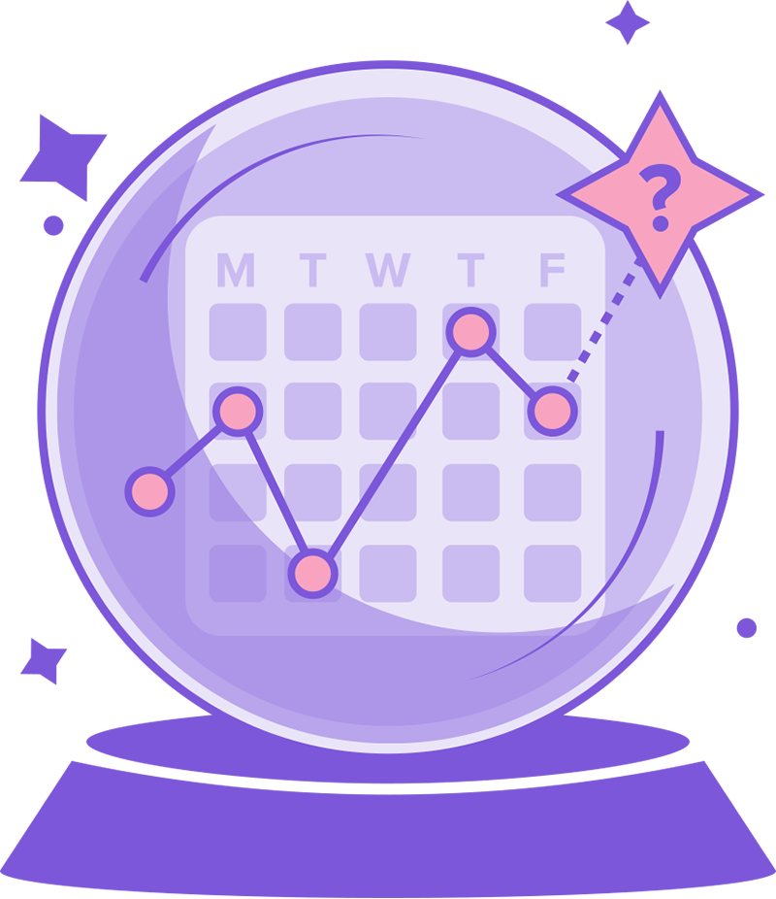
LEADING KPIs PREDICTING FUTURE PERFORMANCE

Slide 11
LEADING KPIs PREDICTING FUTURE PERFORMANCE
Leading KPIs measure activities and trends that influence future outcomes.They act as early warning signals before financial results are visible. Leading KPIs are proactive.They allow intervention before damage occurs.
Examples:
Conversion rate (declining conversion predicts revenue drop)
Pipeline velocity (slower movement predicts delayed income)
Customer engagement rate (low engagement predicts churn)
Sales cycle length (increasing duration predicts slowdown)

Slide 12

LAGGING KPIs CONFIRMING PAST RESULTS

Slide 13
LAGGING KPIs CONFIRMING PAST RESULTS
Lagging KPIs measure outcomes that have already occurred.
They confirm whether business objectives were achieved. Lagging KPIs are reactive. They show results, but not necessarily the cause.
Examples:
Revenue (total money generated from sales before expenses)
Gross profit (revenue minus the direct cost of producing goods or services)
Net income (final profit after all expenses, taxes, and costs are deducted)
Quarterly growth (percentage increase or decrease in performance compared to the previous quarter)

Slide 14
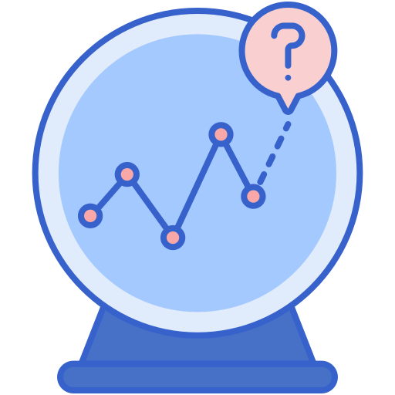

KPI TYPES LEADING VS LAGGING
Leading KPIs predict outcomes
Lagging KPIs confirm past results

Slide 15

ANALOGY VITAL SIGNS MODEL
Doctors monitor heart rate, not individual cells.
Managers monitor KPIs,
NOT transactions.
(Dashboards are business vital signs)

Slide 16
DATA TRANSFORMATION PIPELINE FROM TRANSACTION TO ACTION
Business systems generate raw transactions such as orders, payments, invoices, and customer interactions
Transaction
Individual recorded event (one customer order worth $200)
→ Aggregation → Metric → KPI → Threshold → Decision

Slide 17
DATA TRANSFORMATION PIPELINE FROM TRANSACTION TO ACTION
Aggregation
Combining multiple transactions into summarized data (total daily sales)
Metric
Calculated measurement derived from aggregated data (average order value)
KPI
Strategic metric linked to a business objective (monthly revenue target achievement)

Slide 18
DATA TRANSFORMATION PIPELINE FROM TRANSACTION TO ACTION
Threshold
Defined performance limit that separates acceptable from unacceptable results (profit margin below 15%)
Decision
Management action taken when a KPI crosses its threshold
( reduce costs, adjust pricing, review sales process)

Slide 19
RAW DATA VS METRIC ADDING INTERPRETATION
Data by itself does not explain performance.Metrics give data meaning. Metrics transform events into performance signals
Raw Data: 10,000 orders (this tell us that the company processed 10,000 orders. That’s it.) Is that good or bad?
Were they delivered on time?
Were they profitable?
Did customers wait too long?

Slide 20
RAW DATA VS METRIC ADDING INTERPRETATION
Metric: Average fulfillment time = 3.2 days
Fulfillment time measures: the time between when a customer places an order and when the order is delivered
With this metric we are measuring performance? How?

Slide 21
RAW DATA VS METRIC ADDING INTERPRETATION
3.2 days tells us:
On average, customers waited 3.2 days to receive their order We can compare it to:
Last week (better of worse)
A company target (for example 2 days)
Competitors (example - 4 days)
Now we can evaluate performance

Slide 22
METRIC EXAMPLE
For each order, the ERP system stores (raw data):
Order Date
Delivery Date
Order ID | Order Date | Delivery Date
1001 | Jan 1 2026 | Jan 3 2026
1002 | Jan 1 2026 | Jan 4 2026
1003 | Jan 2 2026 | Jan 5 2026

Slide 23
METRIC EXAMPLE
Calculate fulfillment time per order
Order 1001 → 2 days
Order 1002 → 3 days
Order 1003 → 3 days
Calculate the average Average Fulfillment Time = (2 + 3 + 3) ÷ 3 = 2.67 days

Slide 24
KEY PERFORMANCE INDICATORS STRUCTURE AND PURPOSE
A KPI key prformance indicators:
Links to a business objective (directly supports a specific strategic goal such as growth, profitability, or efficiency)
Has ownership (assigned to a responsible person or department accountable for its performance)
Has measurable limits (includes defined targets or thresholds that distinguish acceptable from unacceptable performance)
Triggers corrective action (requires a response or intervention when performance falls outside defined limits)

Slide 25
KPI LIFECYCLE DEFINE, MONITOR, REVISE
KPIs must evolve with strategy As business priorities change, for example from growth to profitability, or from expansion to efficiency performance indicators must also change to reflect new objectives
Static KPIs eventually mislead If organizations continue measuring outdated targets, they may optimize the wrong behavior, ignore emerging risks, or fail to respond to market shifts

Slide 26
KPI MANIPULATION RISK BEHAVIORAL DISTORTION
If sales performance is measured only by call volume, sales representatives will increase the number of calls made, but the quality of conversations and customer qualification may decline
When a KPI rewards quantity instead of outcome, behavior adapts to maximize the metric rather than the objective
Wrong KPI → wrong behavior

Slide 27
ERP ANALYTICS EXAMPLE INVENTORY TURNOVER
Inventory Turnover = Cost of Goods Sold / Average Inventory
Declining turnover signals:
Cash locked in stock (capital tied up in unsold inventory instead of being used elsewhere in the business)
Storage cost increase (higher warehousing, insurance, and handling expenses due to excess stock)
Operational inefficiency (slow-moving products indicate weak demand forecasting or purchasing problems)

Slide 28
ERP COST CONTROL VARIANCE DETECTION
Cost Variance = Actual Cost − Planned Cost
Threshold breach triggers:
Procurement review (evaluate purchasing decisions, order quantities, and supplier selection to identify cost inefficiencies)
Supplier renegotiation (reassess pricing terms, payment conditions, or delivery agreements to reduce expenses)
Efficiency investigation (analyze internal production or operational processes to identify waste, delays, or resource misallocation)

Slide 29
CRM ANALYTICS EXAMPLE PIPELINE VELOCITY
Pipeline Velocity =(Opportunities × Win Rate × Deal Size) / Sales Cycle Length
Declining velocity predicts revenue slowdown
This metric estimates how quickly revenue is being generated from the sales pipeline.
More opportunities increase potential revenue.
Higher win rate improves conversion efficiency
Larger deal size increases revenue impact
Longer sales cycle slows revenue realization.
If pipeline velocity declines, it signals that future revenue growth may slow, even if current revenue still appears stable.

Slide 30

AMAZON OPERATIONAL CONTROL SYSTEM
Amazon monitors:
Late shipment percentage
Fulfillment time
Inventory aging
Micro signals prevent macro losses

Slide 31
AMAZON OPERATIONAL CONTROL SYSTEM
Late shipment percentage (percentage of orders delivered after the promised delivery date)
Fulfillment time (average time between order placement and successful delivery to the customer)
Inventory aging (length of time products remain in storage before being sold)

Slide 32

NETFLIX CONTENT PERFORMANCE METRICS
Netflix tracks:
Completion rate
Engagement time
Subscriber churn
Analytics determines content investment.

Slide 33
NETFLIX CONTENT PERFORMANCE METRICS
Completion rate (percentage of viewers who watch content from start to finish)
Engagement time (average amount of time users actively spend interacting with the platform or content)
Subscriber churn (percentage of subscribers who cancel their subscription within a given period)

Slide 34

ZILLOW MODEL LIMITATION CASE
Predictive pricing failed due to:
Static assumptions
Market volatility
Delayed feedback loops
Result: $500M+ loss.

Slide 35
ZILLOW MODEL LIMITATION CASE
Static assumptions (models built on fixed expectations that do not adjust when market conditions change)
Market volatility (rapid and unpredictable changes in prices, demand, or economic conditions)
Delayed feedback loops (slow detection of performance problems due to lag between data collection, analysis, and corrective action)

Slide 36
REPORTS VS DASHBOARDS STATIC VS DYNAMIC
Reports explain history They summarize past performance and answer questions such as “What happened last month?” or “How did we perform last quarter?”
Dashboards enable intervention They monitor current performance in near real time and highlight when a KPI crosses a defined threshold, allowing managers to take corrective action immediately.
Report → understanding the past
Dashboard → acting in the present

Slide 37
MULTIPLE VERSIONS OF TRUTH METRIC CONSISTENCY RISK
Sales revenue ≠ Finance revenue
Sales may record revenue when a deal is closed in the CRM system, while Finance records revenue only after the invoice is issued or payment is received in the ERP system
Different definitions create confusion
When departments calculate metrics using different rules, dashboards show conflicting numbers and management loses trust in the data
IT must enforce unified metrics
Data definitions, calculation logic, and reporting rules must be standardized across systems to ensure one version of the truth

Slide 38
DASHBOARD DESIGN RULE ROLE-SPECIFIC CONTROL
One dashboard must serve:
One role
One decision scope
One timeframe

Slide 39
IT RESPONSIBILITY DATA MODELING AND GOVERNANCE
IT professionals:
Define data structures
Maintain ETL logic
Enforce KPI definitions
Prevent duplication
Analytics integrity is technical work.

Slide 40
P001 - KPI CALCULATION ENGINE FROM DATA TO METRICS
Input:
Leads
Conversion rate
Average deal value
Marketing cost
Operational cost
Output:
Revenue
Gross Profit
CAC
Conversion classification

Slide 41
P002 – DECISION ENGINE FROM KPI TO ACTION
Based on KPI classification:
Critical → Review sales process
Negative profit → Reduce costs
Strong performance → Scale marketing
Output exactly one management action.

Slide 42
P003 – TREND ANALYSIS ENGINE COMPARING TWO PERIODS
The program must compare performance between two time periods:
Previous quarter
Current quarter
The system receives the following inputs for both periods:
Revenue
Gross Profit
Conversion Rate
Number of Leads

Slide 43
P003 – TREND ANALYSIS ENGINE TASK REQUIREMENT
The program must detect performance contradictions that indicate hidden risk.
Specifically, detect the following situations:
Revenue increased BUT Gross Profit decreased
Number of Leads increased BUT Conversion Rate decreased
If either condition is true, the system must output: “Hidden Risk Detected”
If neither condition is true, the system must output: “Performance Stable”

Slide 44
P003 – TREND ANALYSIS ENGINE WHY THIS MATTERS
Revenue alone does not guarantee healthy performance
Growth without profitability or efficiency can signal structural problems
Analytics must detect contradictions, not just growth

Slide 45
TREND INTERPRETATION DIRECTION OVER SNAPSHOT
Static numbers can mislead Revenue of $1 million may look strong, but if it has declined for three consecutive months, it signals emerging risk
Direction determines strategy Trends over time → increasing, stable, or declining → guide long-term decisions and resource allocation

Slide 46
WHAT IF MISLEADING DASHBOARD
The executive dashboard shows:
Revenue appears stable
Lead volume is increasing
Conversion rate is declining
Profit margin is shrinking
At first glance, growth seems healthy. However, deeper indicators reveal weakening efficiency and declining profitability. The dashboard highlights activity, but hides structural risk.

Slide 47
WHAT IF MISLEADING DASHBOARD
Same case but in other words
Revenue looks stable but marketing reports more leads.
But conversion efficiency is dropping and profit margins are tightening.
The business appears stable, yet the foundation is weakening.

Slide 48
BUSINESS CONSEQUENCE WRONG DECISION IMPACT
Management increases marketing spend based on stable revenue and rising lead volume
However, the underlying issues → declining conversion and shrinking margins → remain unresolved
More leads enter an inefficient sales process.
Customer acquisition costs increase
Operational pressure rises
Profitability declines
An analytics interpretation failure becomes a financial performance failure

Slide 49
ANALYTICS MINDSET REDUCING UNCERTAINTY
Analytics does not replace managerial judgment, and it does not automate thinking
Its purpose is to identify patterns, detect deviations, and highlight emerging risks before they become visible in financial results
By transforming system data into structured signals, analytics reduces decision uncertainty and supports more informed, evidence-based actions

Slide 50

FINAL TAKEAWAY HAAAAA
SYSTEM → SIGNAL → CONTROL
ERP records operations CRM records customers Analytics transforms signals into control
Dashboards shape behavior. Poor dashboards shape mistakes.

Slide 51
NEXT WEEK PREVIEW WHAT’S COMING
Designing KPIs and decision-safe dashboards

